Slide 1
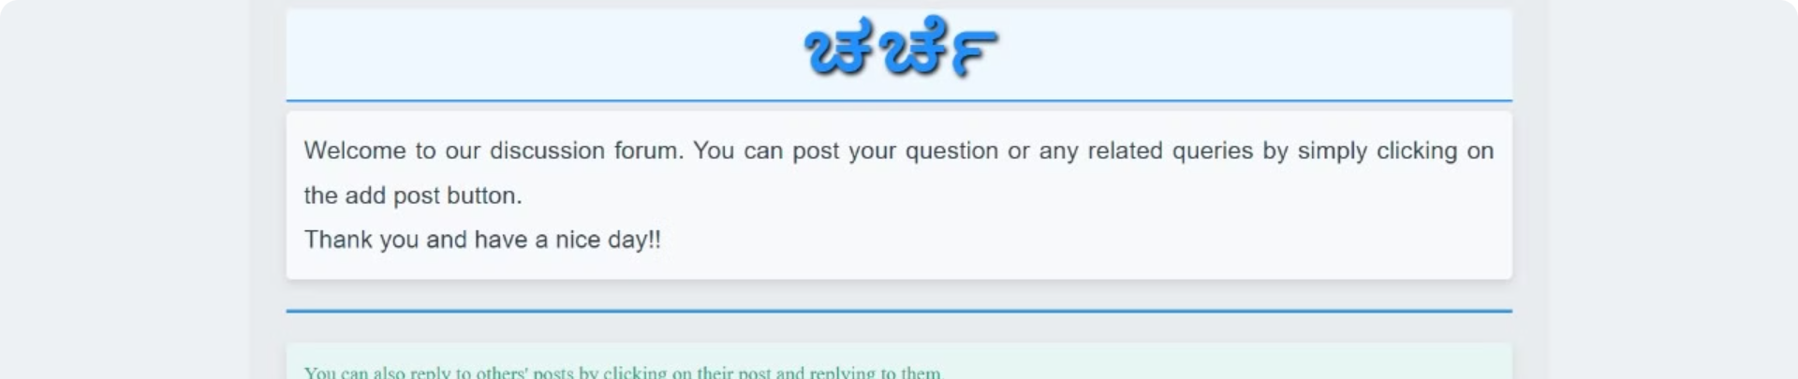
Introduction to 'ಚರ್ಚೆ'
'ಚರ್ಚೆ' is an engaging online discussion forum that brings people together to share ideas, ask questions, and engage in thought-provoking conversations. Built using the powerful Django full-stack framework, it offers a seamless and intuitive user experience.

Slide 2
About Discussion Forum Project
Have you ever heard about Stack Overflow? Yes, in this project, we will build a discussion forum using python Django where all the logged-in users will be able to post their questions or problems or answer other people’s queries if they know about it. This python Django project is for those people who have basic knowledge in Django.
The objective of the discussion forum django project is to implement an online discussion forum where users can post their questions or reply to other people’s questions. Basic knowledge of the front-end part and a good knowledge of Django is required to complete and understand the project.

Slide 3

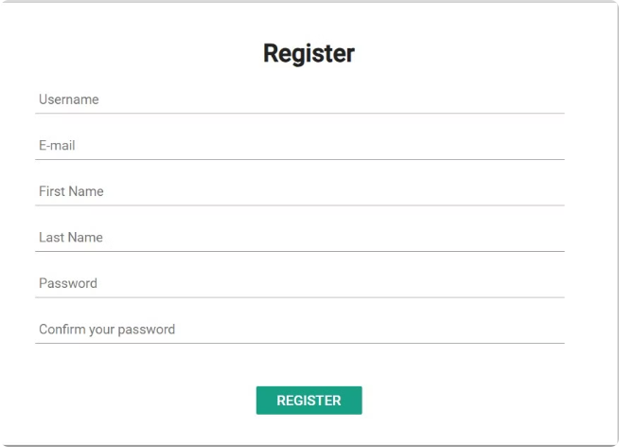
User Registration and Authentication
1
Registration
Users can easily create an account with a secure registration process, ensuring the safety of their personal information.
2
Login
The user can login to his account with his credentials, the system verifies the credentials with the database to grant or deny login access
3
Profile Management
Users can customize their profiles; the registered credentials are displayed here to the user and also, he has option to update his profile photo from the default user profile photo

Slide 4

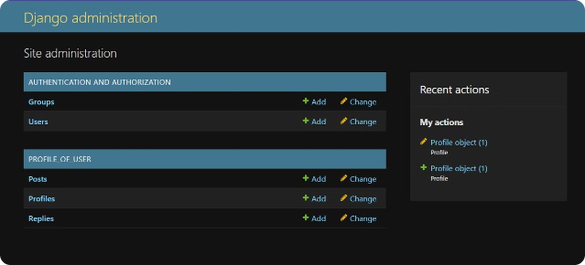
Creating and Managing Discussion Threads
1
Thread Creation
Users can easily start new discussion threads on a variety of topics, fostering engaging conversations.
2
Thread Moderation
Administrators can monitor and moderate discussion threads, ensuring a respectful and constructive environment

Slide 5

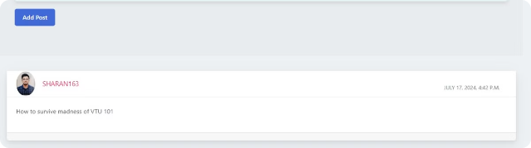
Posting and Replying to Comments
Seamless Commenting
Users can easily post comments, engage in discussions, and respond to others' thoughts and ideas.
Nested Replies
The platform supports nested replies, allowing users to follow the flow of conversation and dive deeper into specific topics.

Slide 6
Concepts used:
Frontend
HTML, CSS(Bootstrap)
Models, Views and Templates
Purpose: Define the data structure.
Handle the logic for different URL routes.
Define the structure layout of the HTML pages
Template Inheritance
The forum, profile, login, discussion and register templates extend the basic HTML template that holds the header and footer
Database
SQL lite 3 - a database engine that facilitates embedded database for standalone applications

Slide 7

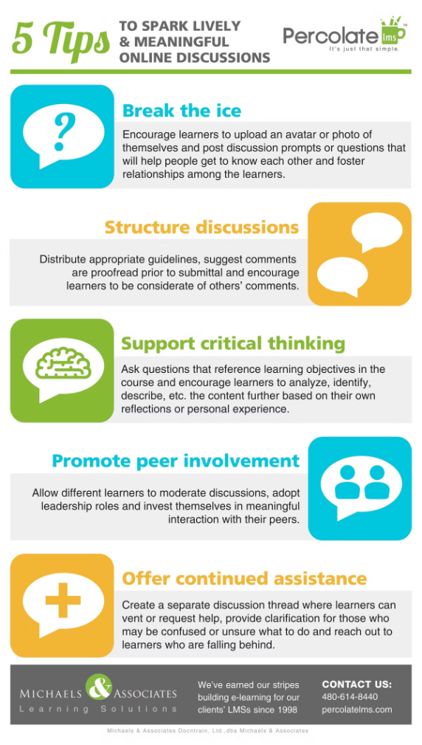



Future Enhancements and Roadmap
Mobile Optimization
Enhance the user experience by optimizing the forum for seamless access on mobile devices.
AI-Powered Moderation
Implement advanced AI-based moderation tools to automate the detection and resolution of problematic content.
Integration with Third-Party Services
Explore integrations with other platforms and services to enhance the overall user experience.

